Slide 1
GinkoBiloba
Technologica internship

Slide 2
Team configuration
Ilian Iliev idiliev18@codingburgas.bg 10a
Jacqueline Yordanova zoyordanova18@codingburgas.bg 10g
Tsvetan Tinev tatinev18@codingburgas.bg
Alexandra Laleva adlaleva18@codingburgas.bg

Slide 3









Used technologies

Slide 4
Future enhancesments
More user-friendly interface
Code optimization

Slide 5
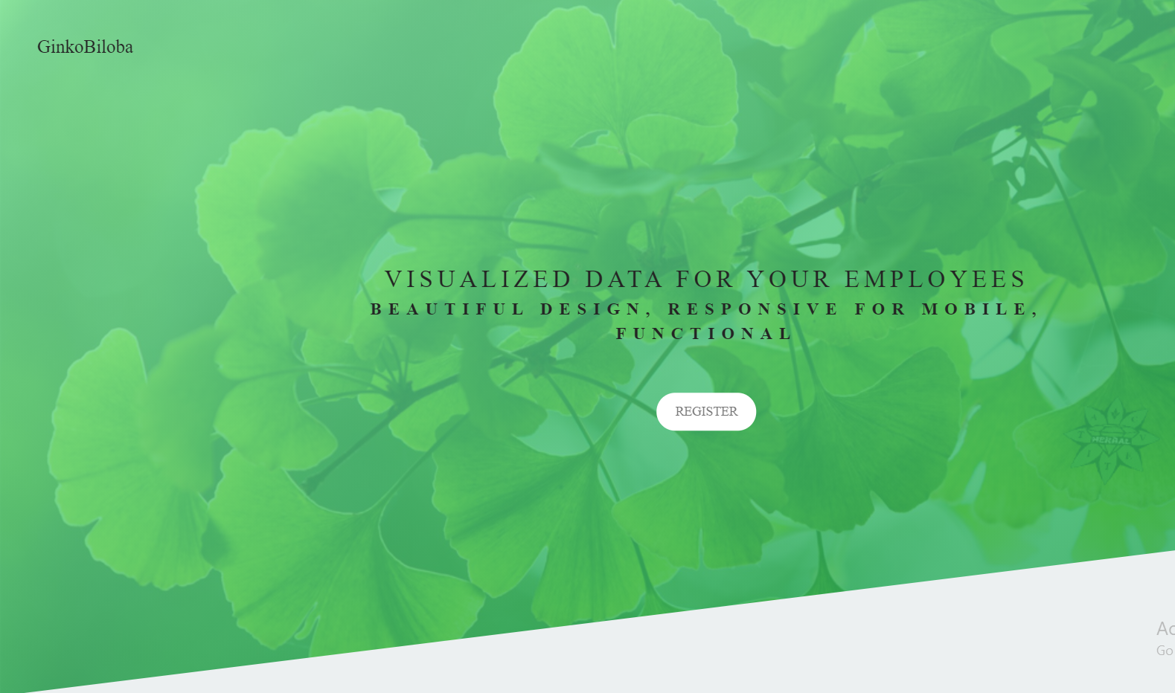
About the website
It is created with Angular
Without bootstrap

Slide 6
Coclusion
The final product was created with a lot of effort and good organization and future ideas and improvements are on the way.

Slide 7
Thank you for your attention!

